Slide 1
Use this reference slide deck to help answer questions and gain additional information for your journey.

Slide 2
Index Slide #2 Roles & Responsibilities Slide # 7 Map & Routes Slide #14 Resources (Packed Sledge Info) Slide # 17 Trading Slide # 23 Weather and Consumption of Resources Slide # 29 Collecting Specimens Slide # 32 Barometers Slide # 34 Supply Depots Slide # 38 Flare Gun Slide # 40 Journals

Slide 3
Roles and Responsibilities

Slide 4
ROLES
Designate ONE person in your team to be the LIASON. This person will become a “co-host” and will be able to leave their breakout room to ask the Expedition Leader questions or trade with other teams during the 2-minute weeks.
BREAKOUT ROOM
MAIN ROOM: Receive the weather update
BREAKOUT ROOM
BREAKOUT ROOM

Slide 5
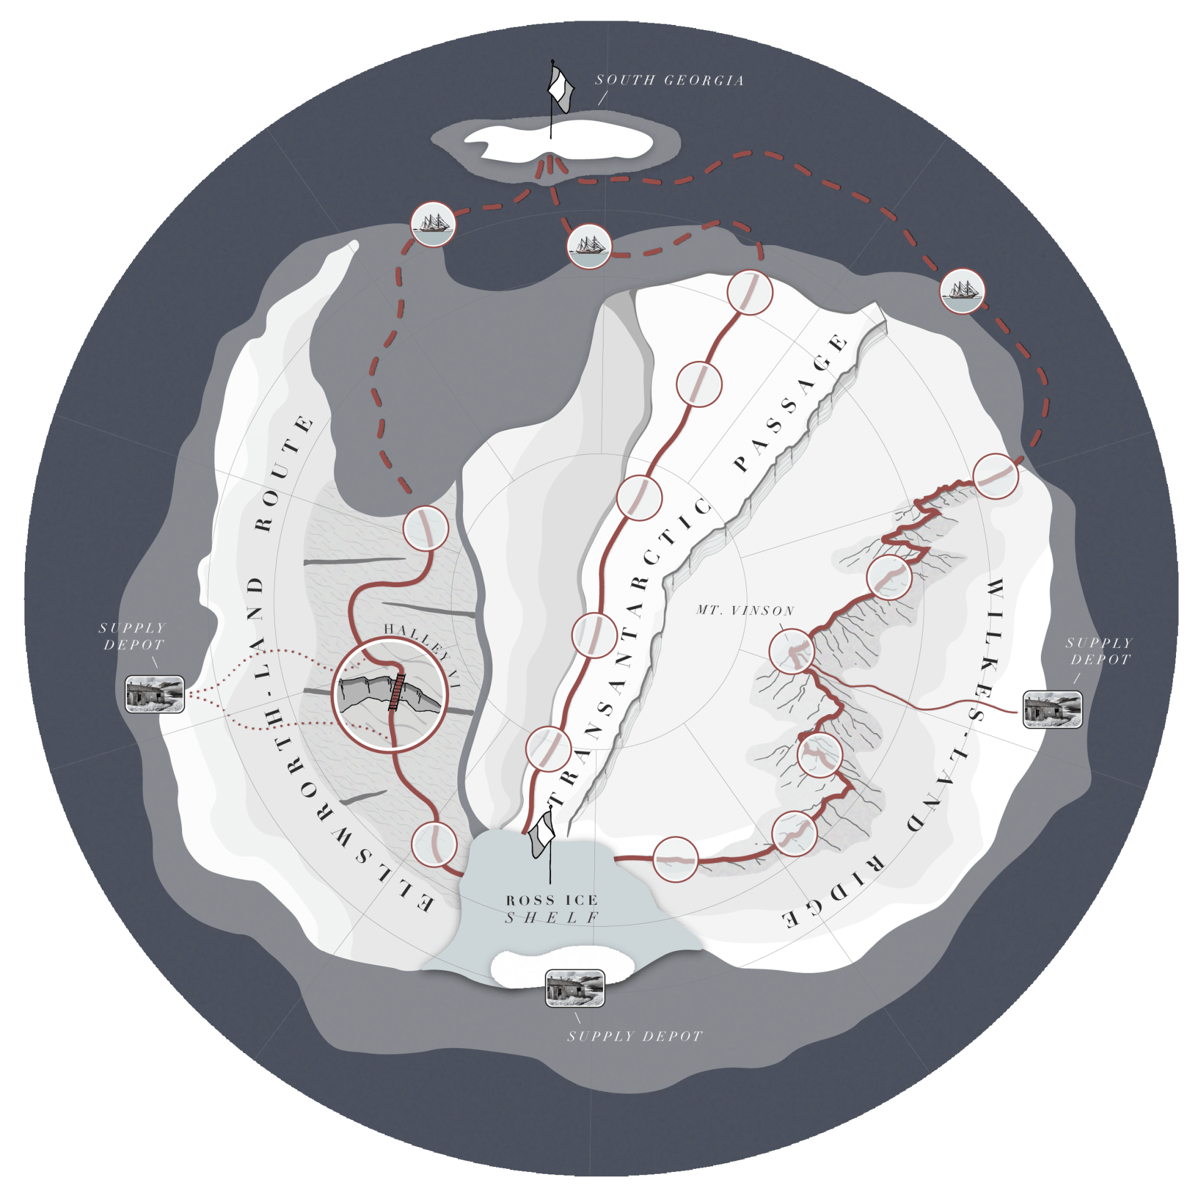
ROLES
Designate TWO people in your team to be the PLOTTERS. These people will be responsible for moving the “number token” on the map each week.
Two people are needed in case of technical glitches. One person backs-up the other.
Notes:
Have everyone move the number 1 to South Georgia and then move it back to its original place.

Slide 6
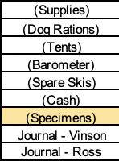
ROLES
Designate TWO PEOPLE in your team to be the team STATISTICIANS. These people will record trades and resource expenditures into the spreadsheet and ensuring accuracy during each of the 2-minute weeks.
Two people are needed in case of technical glitches. One person backs-up the other.

Slide 7
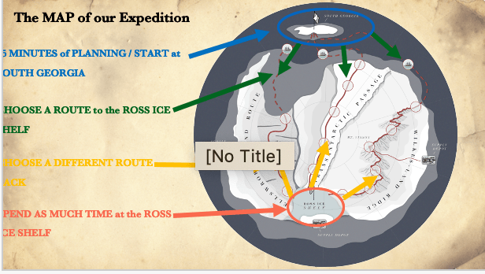
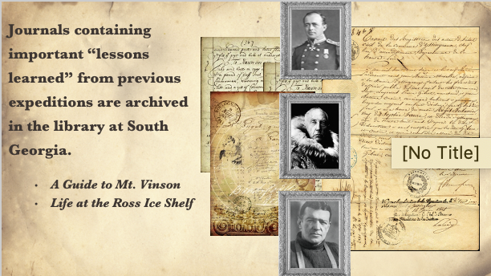
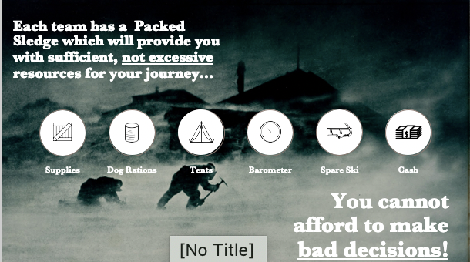
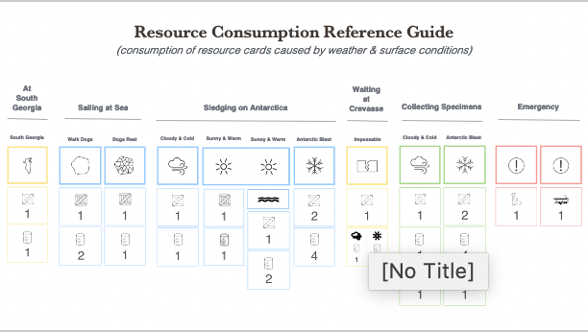
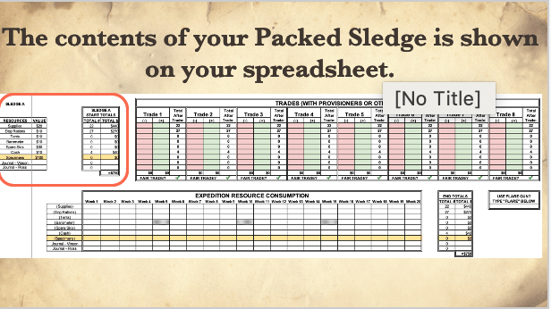
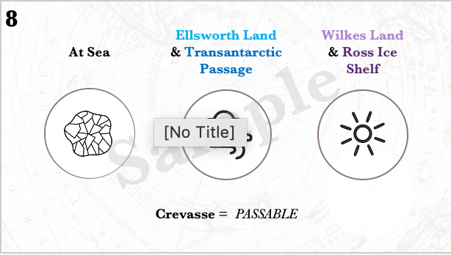
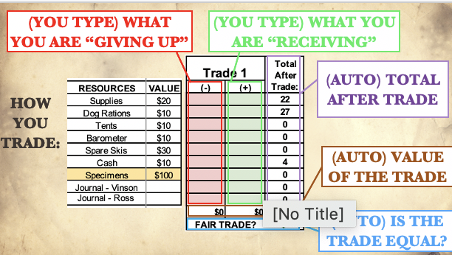
ROLES
Designate TWO people in your team to be the team Researchers. These people will study and review the slide deck to clarify questions and confirm assumptions.
There was a lot of information giving in this presentation. You team now has all of the information it needs but use the slide deck to for any additional information and details you might not remember.
Two people are needed in case of technical glitches. One person backs-up the other.

Slide 8
Map & Routes

Slide 9
The MAP of our Expedition
15 MINUTES of PLANNING / START at SOUTH GEORGIA
CHOOSE A ROUTE to the ROSS ICE SHELF
CHOOSE A DIFFERENT ROUTE BACK
SPEND AS MUCH TIME at the ROSS ICE SHELF

Slide 10
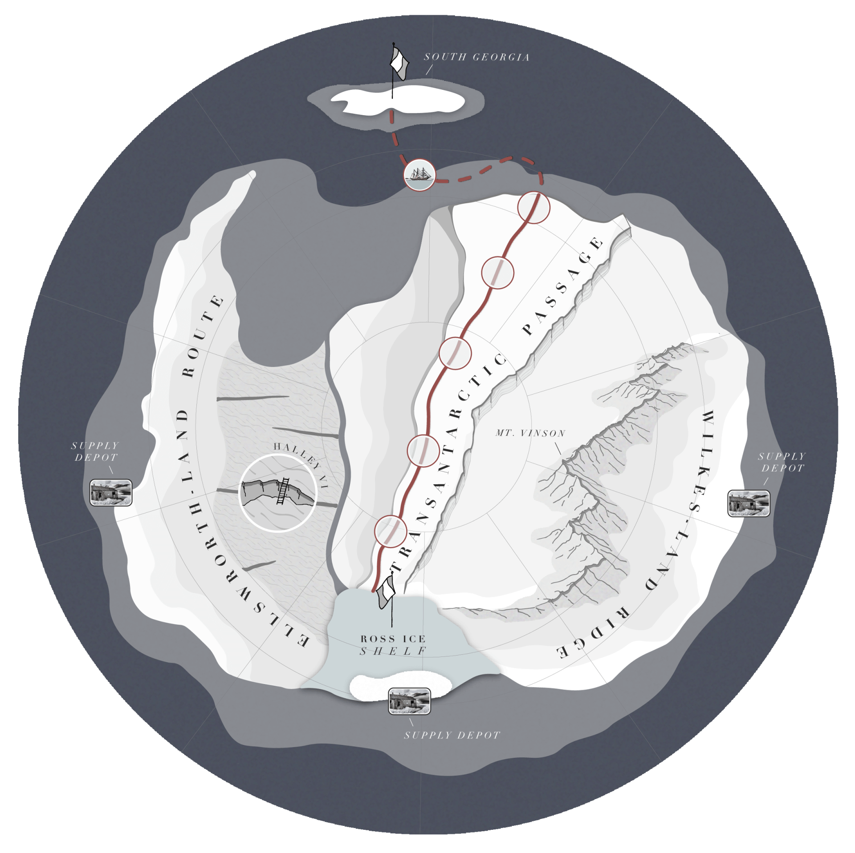
Routes to the Ross Ice Shelf
1
2
3
1
Transantarctic Passage
4
5
6
7
Notes:
The Transantarctic Passage is a pretty straight forward route and it will take your team 7 weeks to reach the Ross Ice Shelf.

Slide 11
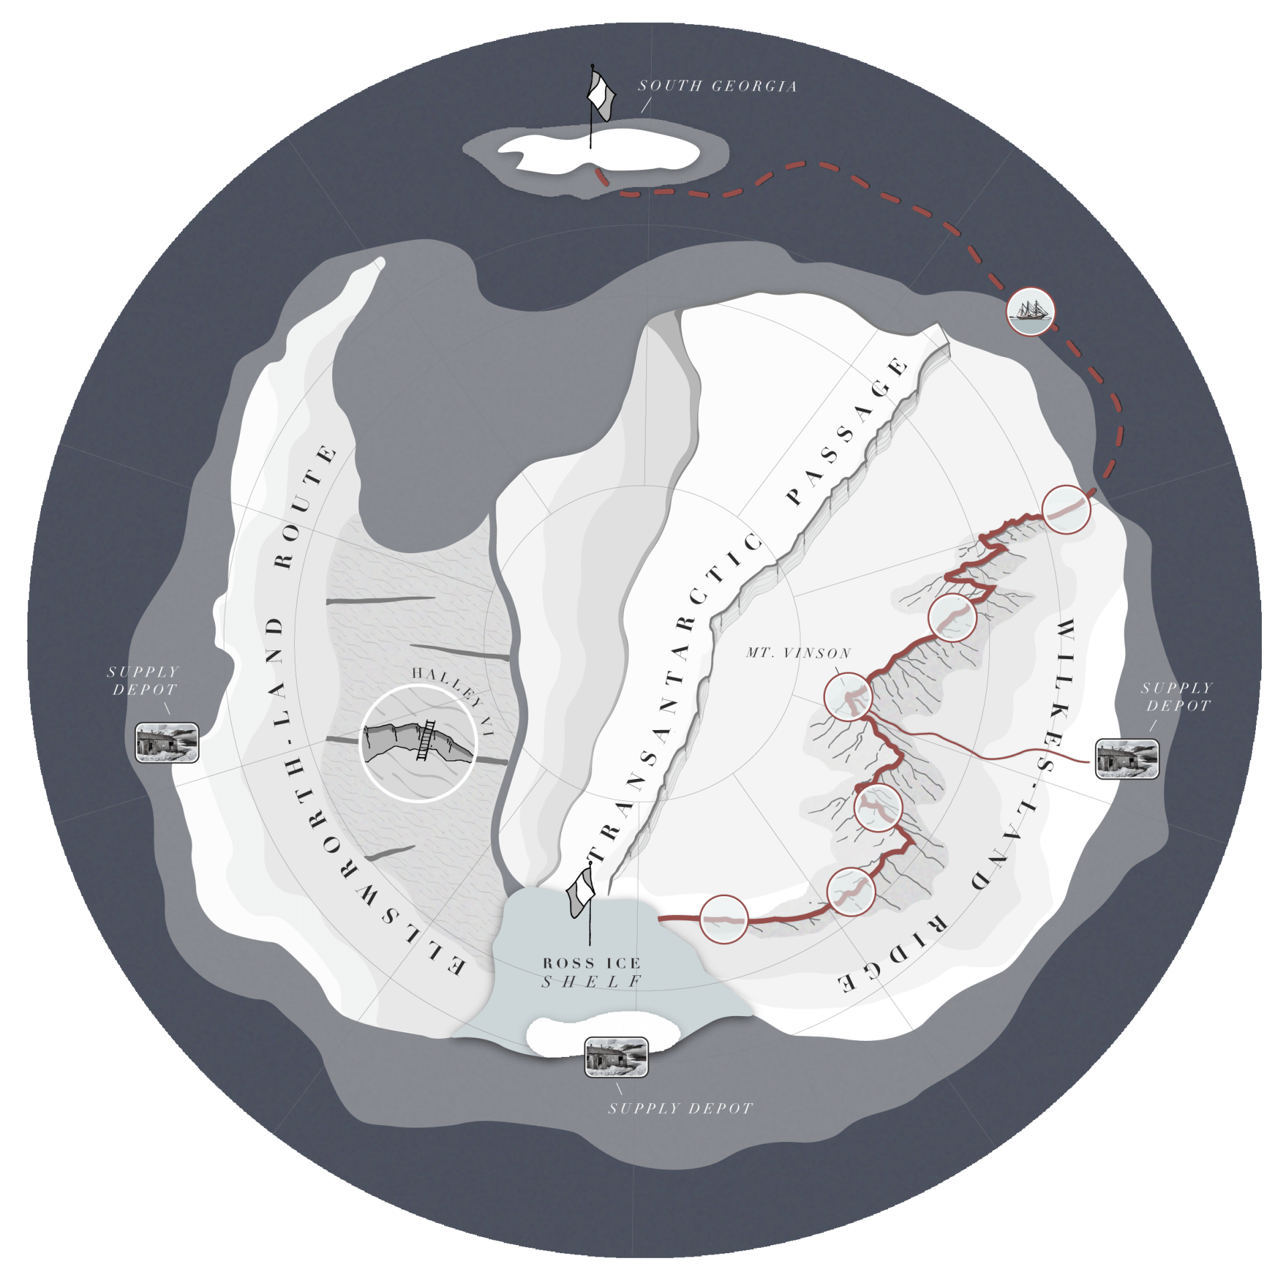
Routes to the Ross Ice Shelf
1
2
Wilkes-Land Ridge
2
3
4
5
6
8
7
Notes:
The Wilkes-Land Ridge is the longest route and crosses the highest point on Antarctica, Mount Vinson. In this example the route will take 8 weeks to get to the Ross Ice Shelf.

Slide 12
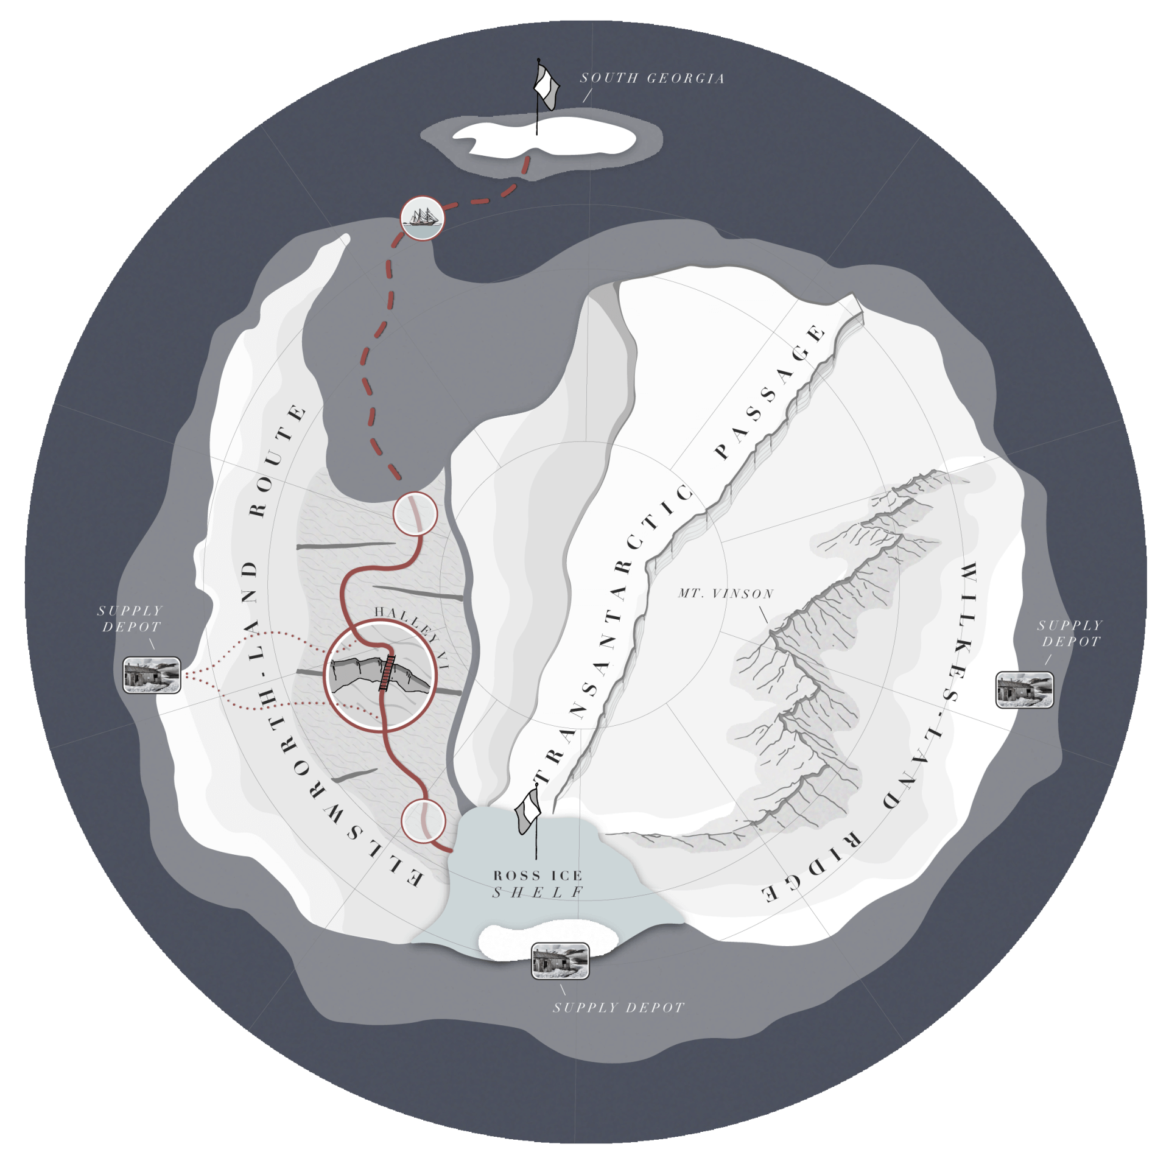
Routes to the Ross Ice Shelf
1
Ellsworth-Land Route
3
2
3
4
5
Notes:
The Ellsworth-Land Route is the shortest route with 5 weeks of travel. However….click

Slide 13
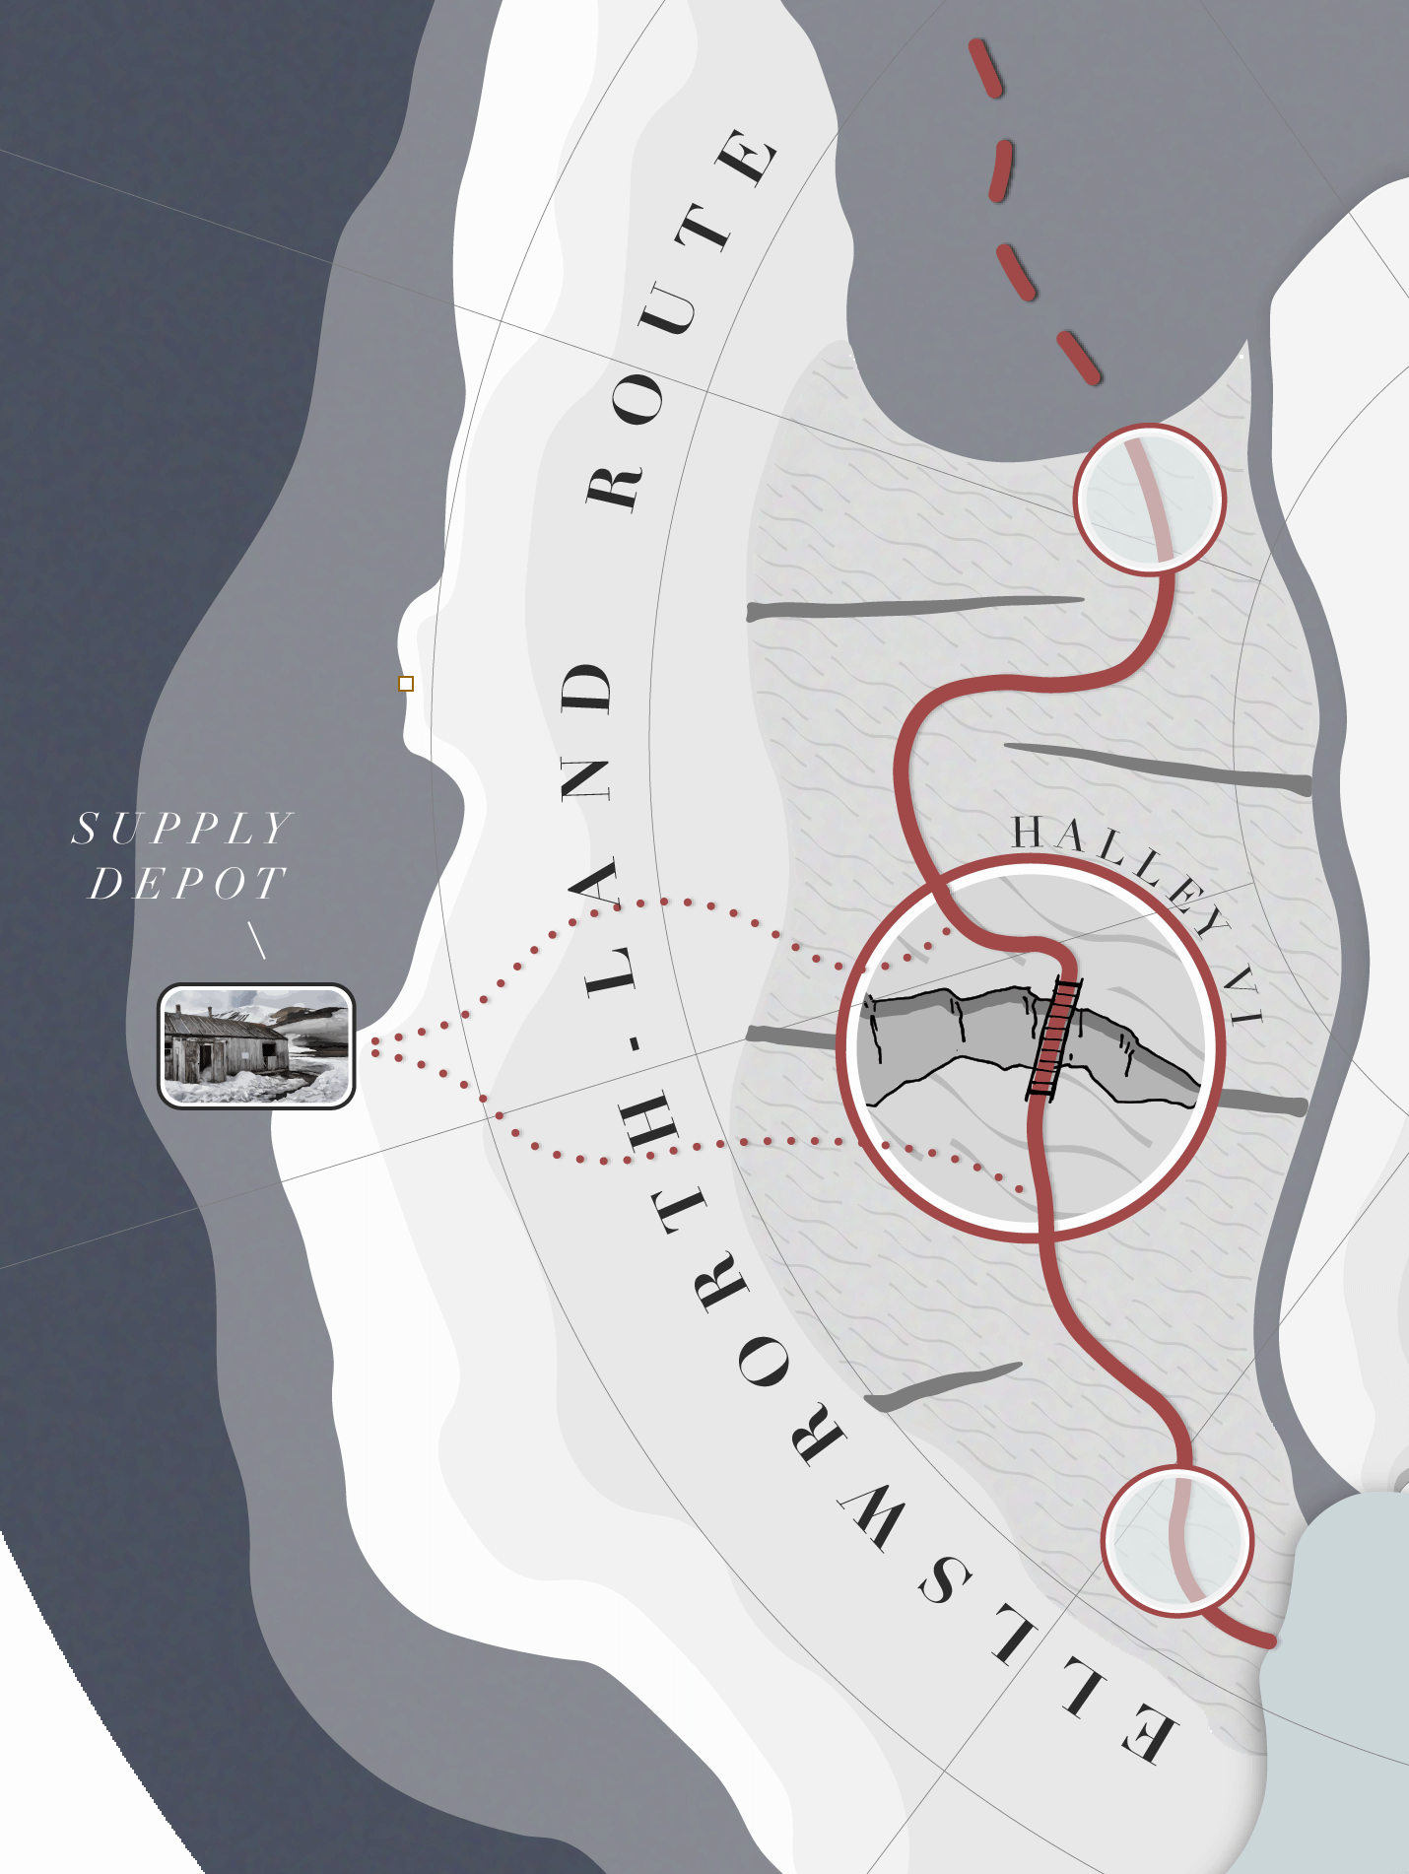
On the Ellsworth-Land route you will encounter the Halley VI crevasse. If you see an empty rectangle on the weather report, the crevasse is passable. Move your token across the crevasse but still in the same large circle.
2
3
= Passable
4
Notes:
You will encounter Halley IV, a deep crevasse that could slow your progress. Normally, if the crevasse is passable, your team may cross the crevasse on your third week. However…click

Slide 14
Halley VI Crevasse
Your game piece cannot cross the crevasse. Wait “before” the crevasse until you are able to cross.
2
= Impassable
3
When the crevasse becomes passable, then just cross over the crevasse but stay inside the same large circle.
4
5
In the example to the right, the crevasse is Impassable on Week 3 but has become Passable on Week 4.
Notes:
If the crevasse is impassable on week 3, you will not be able to cross therefore your team will be stuck and will not be able to cross until it becomes passable. In this example, the crevasse becomes passable on week 4 so your team will cross over but still stay within the same “circle” In this example, it would add 1 week so your team would arrive at the Ross Ice Shelf on week 6

Slide 15
Resources

Slide 16
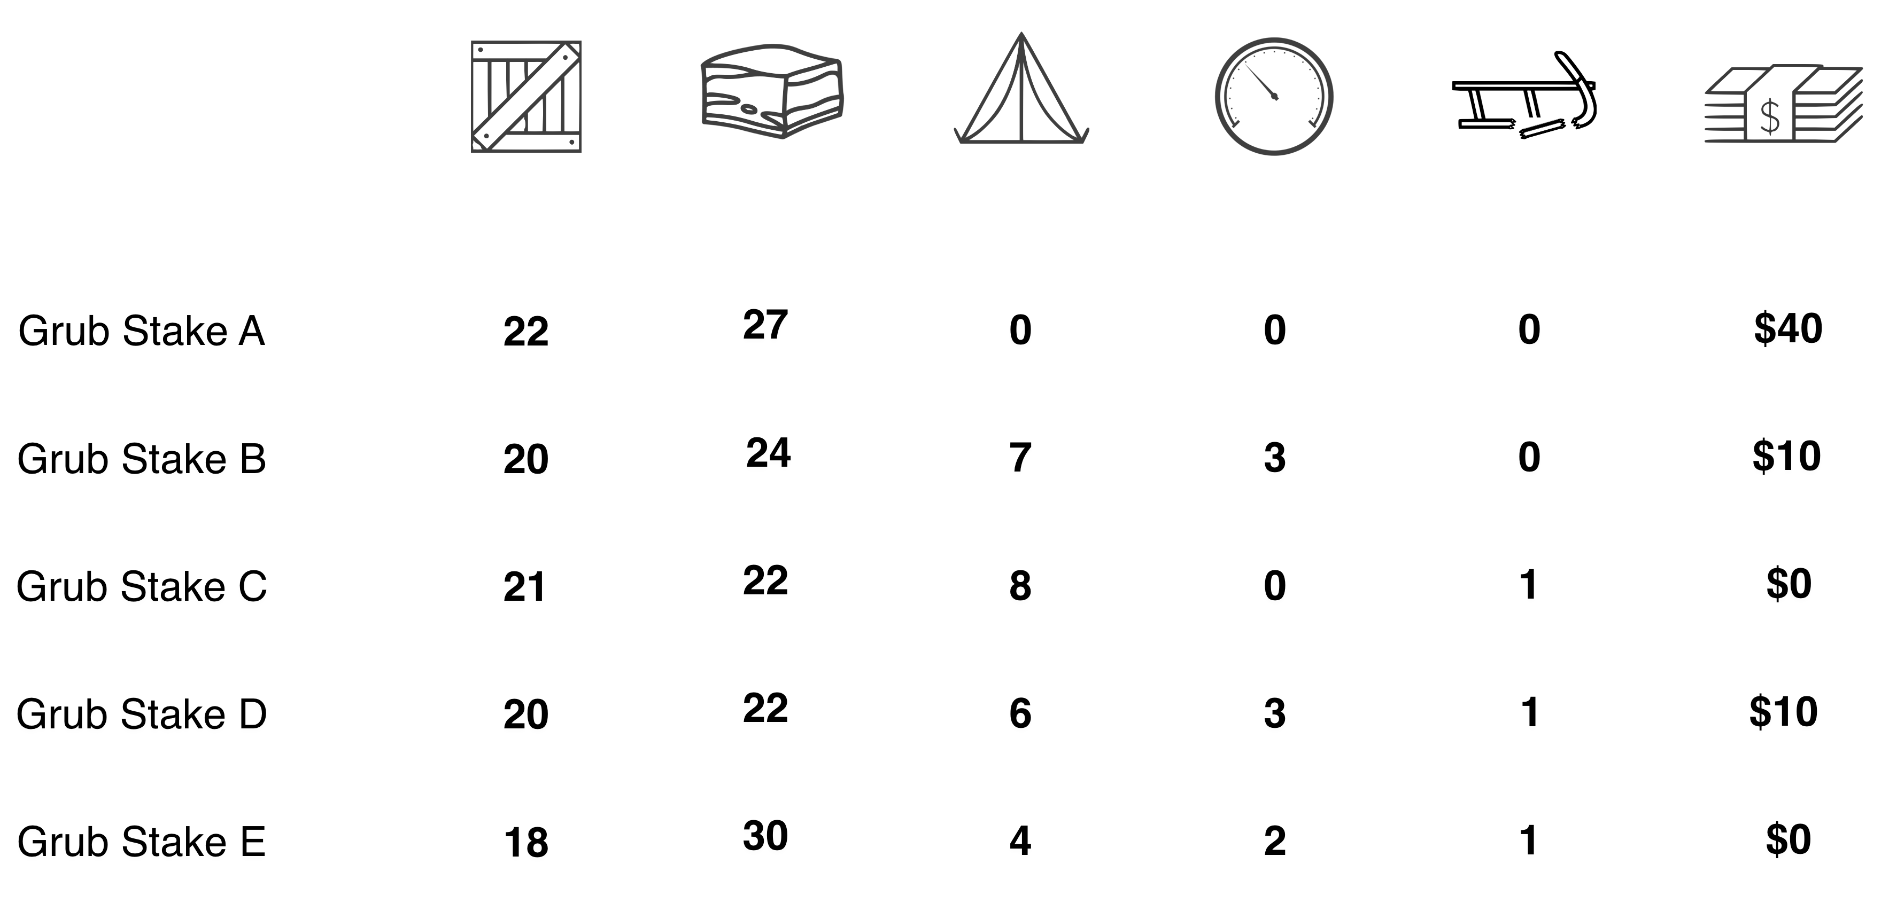
All Packed Sledges contain slightly different combination of resources but all have an equal value of $750
Packed Sledge (Cigar Box)
Your table has been given one of these Packed Sledge cigar boxes of dog rations, supplies and other resources. Each sledge is equipped with a Flare Gun (card) and some with a barometer. You may find these basic kits helpful as is, or make changes to them to match your plans. It is recommended that you adjust your resources so that they make the most sense given your plan of action. You can exchange resources at South Georgia or by entering any of the 3 Supply Depots on the map. Remember that your goal is to get to the Ross Ice Shelf, stay there and collect as many specimens as possible.
Packed Sledge A
Packed Sledge B
Packed Sledge C
Packed Sledge D
Packed Sledge E
The total value of each Packed Sledge = $750
Notes:
You can find this Packed Sledge form in your packet. This allows your team to see what other team’s sledges contain and to show you that no individual team has any ADVANTAGE over other teams. All sledges have a value of $750

Slide 17
The contents of your Packed Sledge is shown on your spreadsheet.

Slide 18
Trading

Slide 19
Anytime your team want to “GIVE UP” or Exchange resources, you will use the “TRADES” section of your Spreadsheet for EACH transaction.

Slide 20
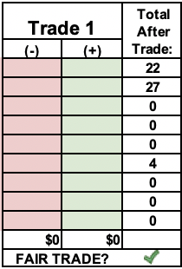
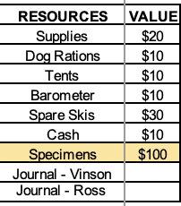
(YOU TYPE) WHAT YOU ARE “GIVING UP”
(YOU TYPE) WHAT YOU ARE “RECEIVING”
(AUTO-CALCULATION) TOTAL AFTER TRADE
HOW YOU TRADE:
(AUTO-CALCULATION) TOTAL AFTER TRADE
(AUTO-CALCULATION) IS THE TRADE EQUAL?
Notes:
Tell them about all parts of the trade
They must type what they give up (-)
They must type what they receive (+)
Total is added based on (+) and (-)
The Value is added based on the (+) and (-)
IF the value of (+) and (-) are EQUAL then the TRADE IS FAIR, you get a check mark. IF THE TRADE IS NOT FAIR, you get an “X”

Slide 21
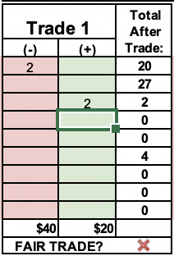
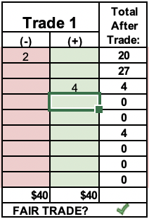
TRADING at South Georgia or at a Supply Depot
MUST GET a GREEN CHECK MARK
NOT EQUITABLE
EQUITABLE

Slide 22
Trading with other teams may not always be fair and equitable.
A GREEN CHECK MARK OR RED X are OK.
BOTH ARE OK
Notes:
Change to TRADE 2 for this example

Slide 23
There are two kinds of trades you can make:
TRADE AT SOUTH GEORGIA OR AT A SUPPLY DEPOT
TRADE WITH OTHERS
At South Georgia or any SUPPLY DEPOT (See next slide)
Anywhere
Where?
Are always (must be) FAIR and EQUITABLE – a true dollar-for-dollar trade
May not be an equal, dollar-for-dollar trade
Fairness?

Slide 24
Weather & Consumption of Resources

Slide 25
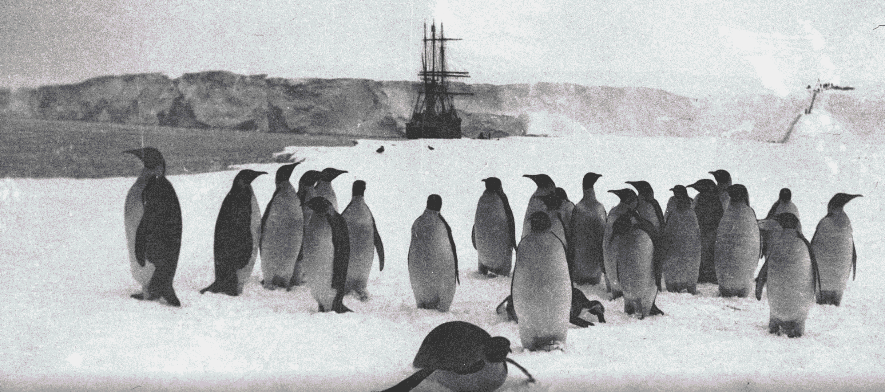
We will show the Weather Pattern and other conditions at the beginning of each week.
Notes:
Review these icons. There is an Icon Key in your info packet.
Show the PASSABLE and IMPASSABLE crevasse icons.

Slide 26
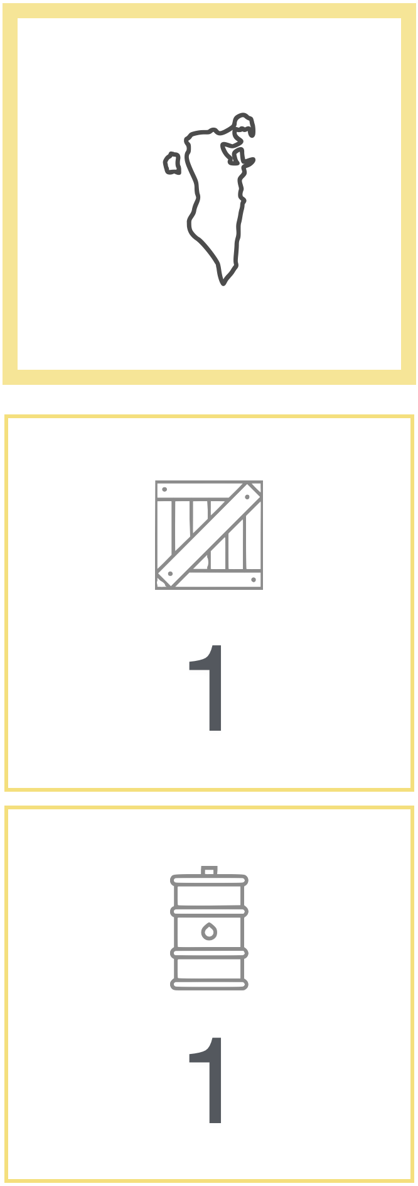
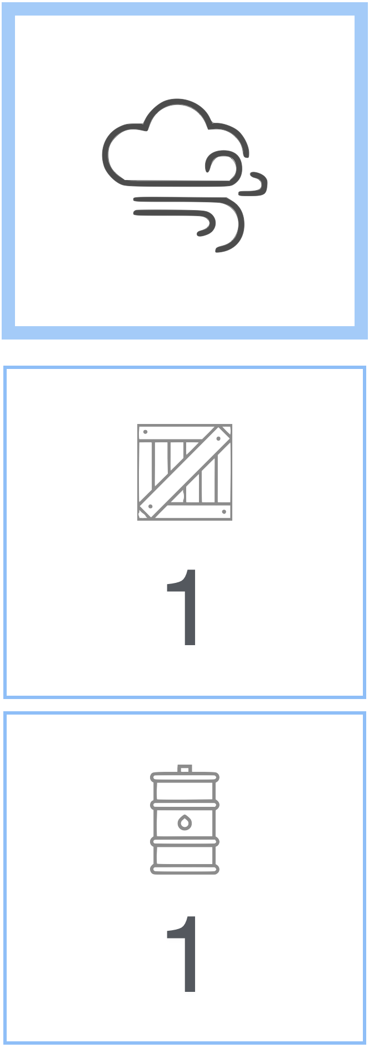
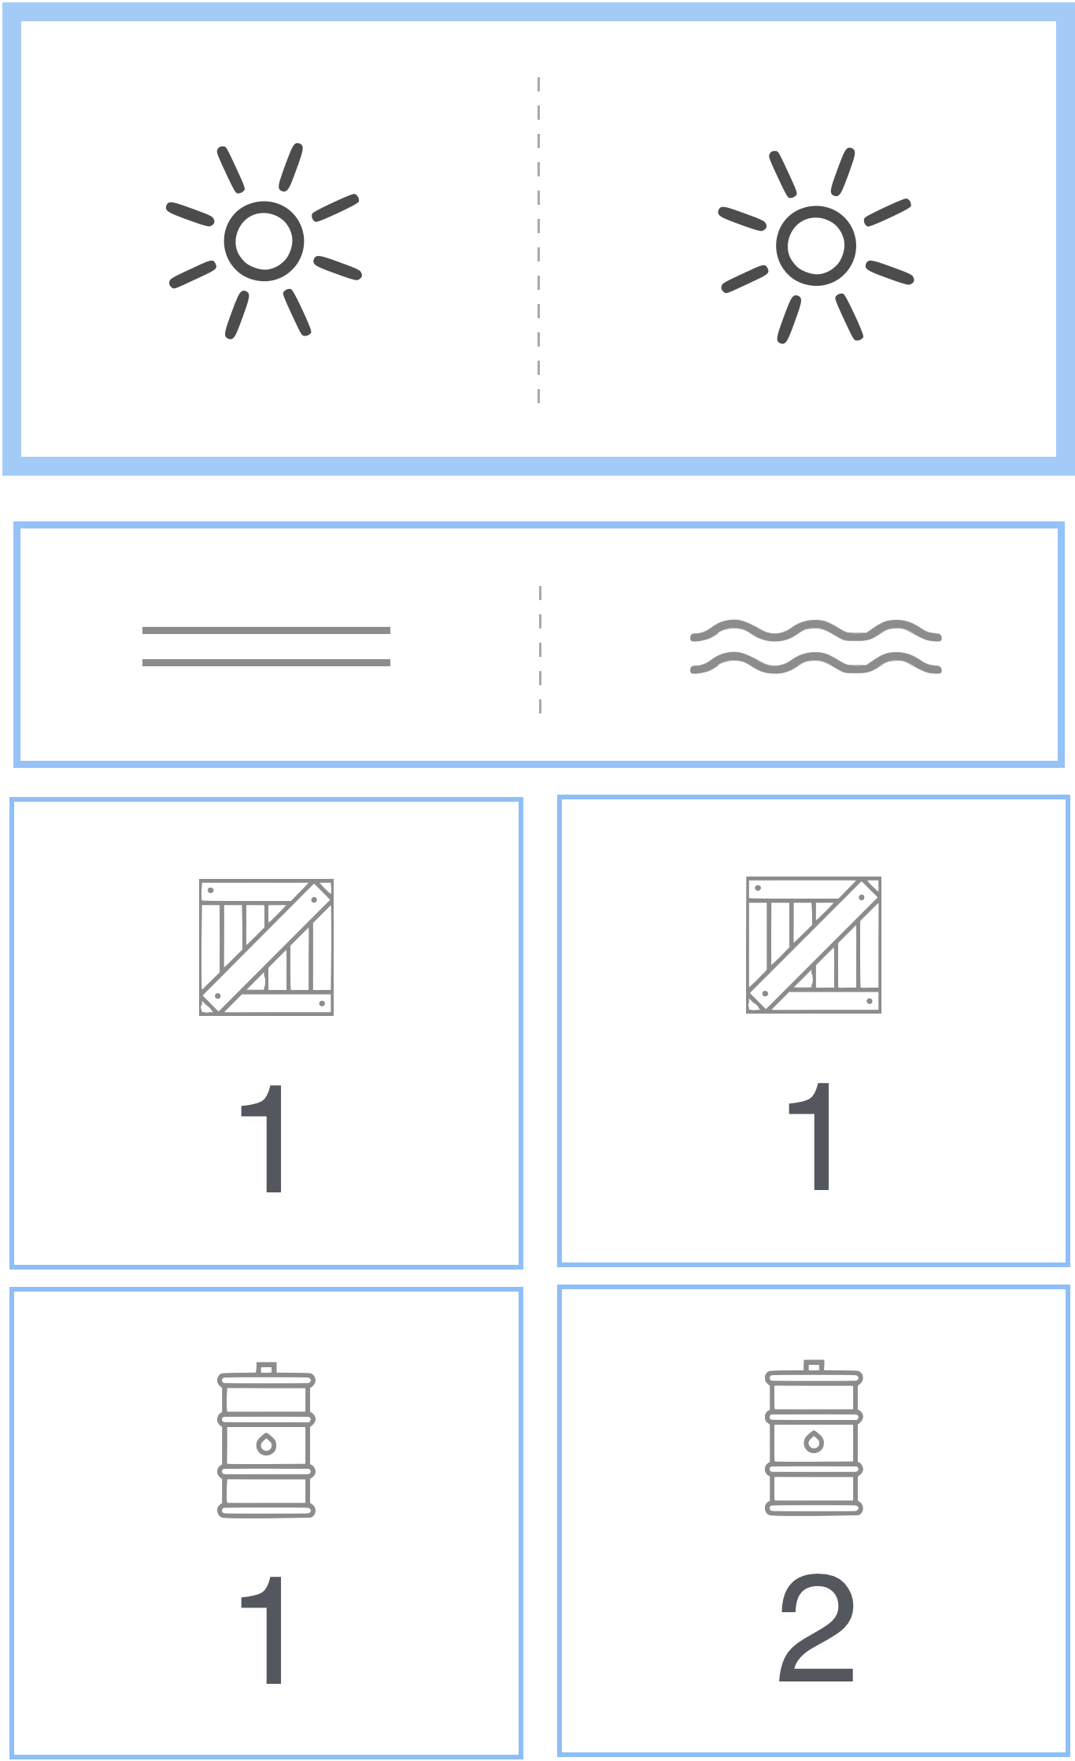
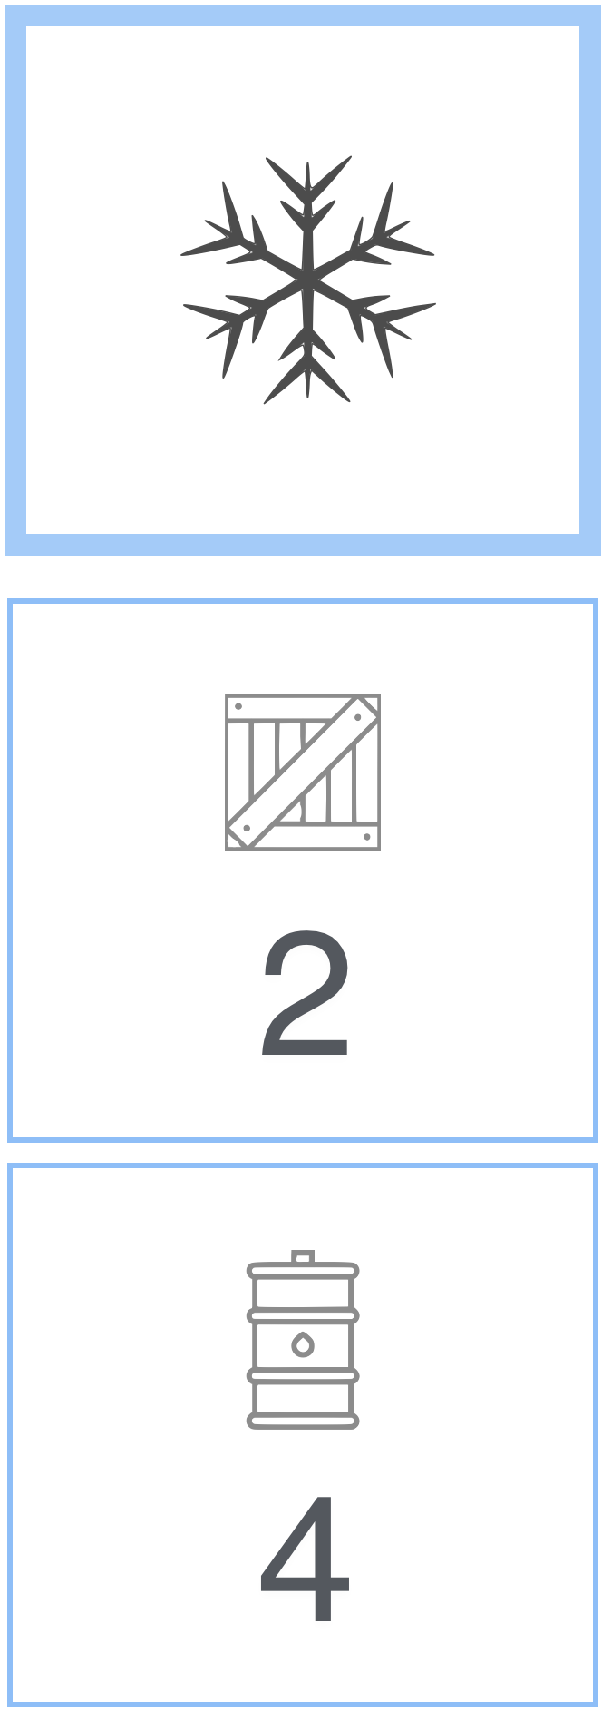
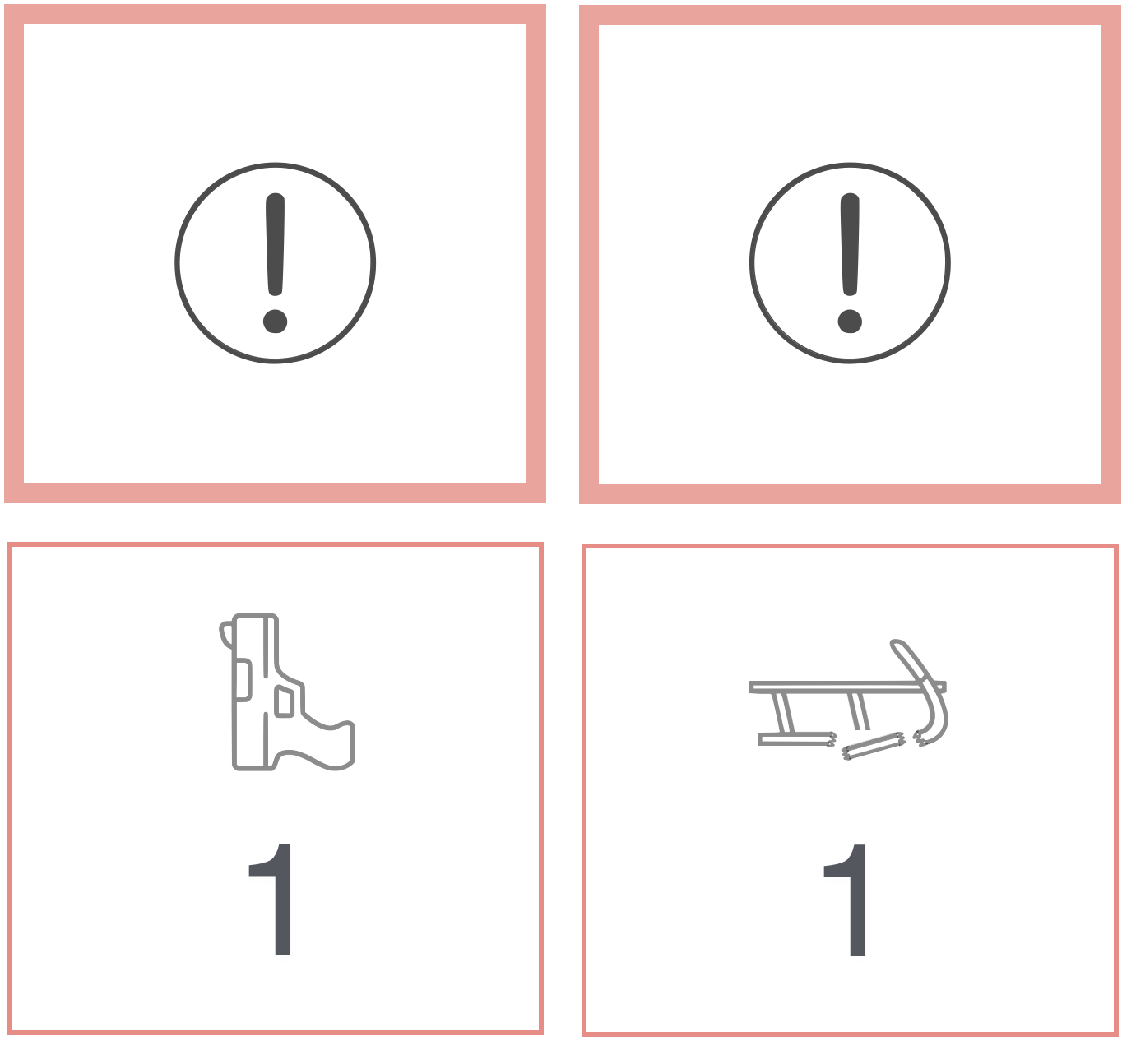
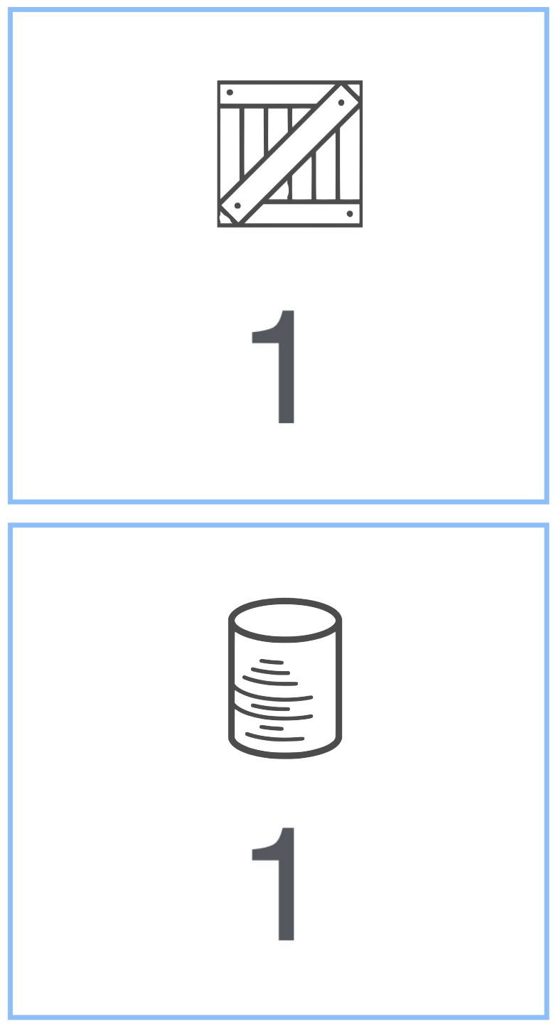
Resource Consumption Pattern Summary
(consumption of resource cards caused by weather & surface conditions)
At South Georgia
Waiting at Crevasse
Sailing at Sea
Sledging on Antarctica
Collecting Specimens
Emergency
South Georgia
Walk Dogs
Dogs Rest
Cloudy & Cold
Sunny & Warm
Sunny & Warm
Antarctic Blast
Impassable
Cloudy & Cold
Antarctic Blast
1
2
Ellsworth-Land Route ONLY

Slide 27
Ice conditions at sea affect the consumption of Dog Rations while at sea.
After leaving South Georgia, your first move will be sailing at sea.
Exercise dogs when Pack Ice is SOLID and consume 2 Dog Rations and 1 Supply.
Do not exercise dogs when Pack Ice is CRACKED and only consume 1 Dog Ration and 1 Supply.
Notes:
When sailing at SEA…
Exercise dogs when Pack Ice is solid and consume 2 Dog Rations and 1 Supply card.
Do not exercise dogs when Pack Ice is cracked and only consume 1 Dog Ration and 1 Supply card.

Slide 28
YOU MUST document your Consumption using your SPREADSHEET
(YOU TYPE)
YOUR CONSUMPTION
YOUR TOTAL IS AUTOMATICALLY UPDATED

Slide 29
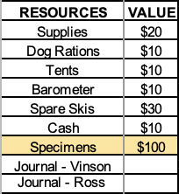
AS YOU MAKE TRADES and CONSUME RESOURCES –
IF YOU SEE RED IN THE “END TOTALS”
THIS MEANS YOU HAVE OVER CONSUMED, or typed something in a wrong spot.
1. CHECK YOUR CONSUMPTION/TRADES IF YOU SEE RED HERE
2. OR ASK A PROVISIONER/ EXPEDITION LEADER FOR HELP

Slide 30
Collecting Specimens

Slide 31
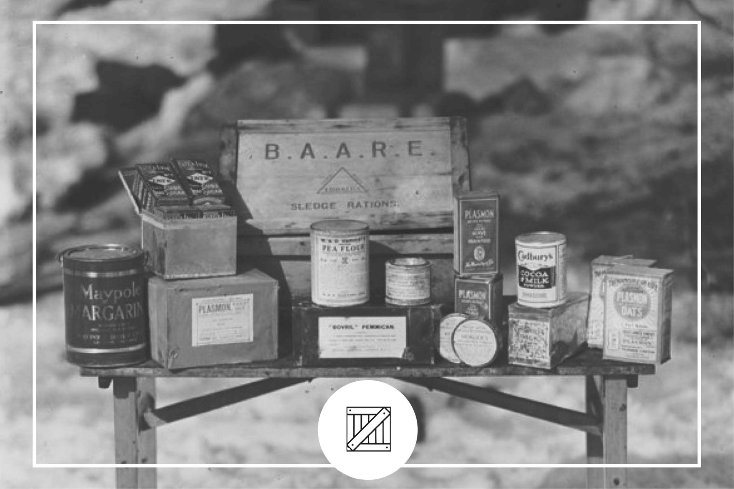
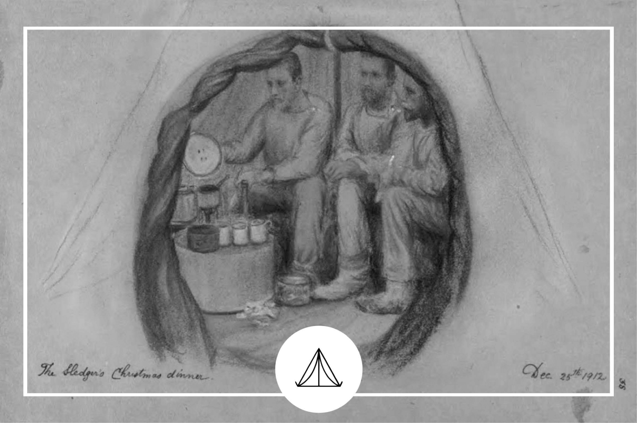
You must plan to have SHELTER for the weeks your team will be Collecting Specimens.
(1)
(1)
(1)
Notes:
If you are collecting specimens at the Ross Ice Shelf you consume:
1 Supply, 1 Dog Ration and 1 Shelter - Shelter is only required when collecting specimens.
You consume Shelter only when collecting Specimens

Slide 32
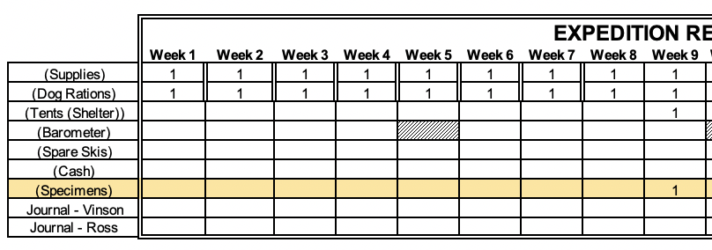
YOU COLLECT A SPECIMEN AUTOMATICALLY WHEN YOU USE A TENT/SHELTER.
(YOU TYPE)
YOU BEGIN COLLECTING SPECIMENS – YOU USE A TENT/SHELTER
YOU AUTOMATICALLY COLLECT A SPECIMEN

Slide 33
Barometers

Slide 34
YOU MAY ONLY USE A BAROMETER on weeks 5, 10, and 15
Marked with a striped cell.
MUST TELL A PROVISIONER YOU HAVE TRADED A BAROMETER FOR THE WEATHER FORECAST:
You will be sent the weather forecast in the Zoom chat by a provisioner.
Notes:
Barometers can predict weather forecasts.
Weather Forecasts are available on weeks: 5, 10 & 15.
Each forecast requires one Barometer.
Each card is turned in at the Trading Post.

Slide 35
Supply Depots

Slide 36
Ellsworth-Land Route
1
It will cost you two weeks to move into and out of the Supply Depot.
2
3
4
5
6
7
Notes:
On the Ellsworth-land Route, you must leave from the large circle area and follow the path to the Supply Depot and follow the other trail back to the same circle. Doing this would add 1 or 2 weeks depending on the condition of the crevasse. In this example, if you visit the supply depot you will not get to the Ross Ice Shelf until Week 7.

Slide 37
Wilkes-Land Ridge
1
It will cost you two weeks to move into and out of the Supply Depot.
2
3
6
4
5
7
8
10
9
Notes:
Similarly, you will leave from Mt. Vinson to get to the Supply Depot and return to Mt. Vinson before continuing on to the Ross Ice Shelf. This will also extend your journey by 2 weeks.

Slide 38
The Supply Depot near the Collection area is a three week journey. One week to the white land mass, one week into the Depot and one week back to the Collection area (Ross Ice Shelf).
1
3
2
Notes:
The Supply Depot near the Collection area is a three week journey. One week to the white land mass, one week into the Depot and one week back to the Collection area (Ross Ice Shelf).

Slide 39
Flare Gun

Slide 40
IF YOU MUST USE YOUR FLARE GUN:
TYPE “FLARE” in the box indicated on the bottom right of your spreadsheet.
It will automatically remove half of your specimens from your end total.
Notes:
Using the Flare Gun will only give you the resources to get back to South Georgia by Week 20. You still need to travel from your current location back to South Georgia. You cannot use the strategy to stay at the Ross Ice Shelf until Week 19 and then be “rescued” and be taken back to South Georgia by Week 20.

Slide 41
Journals

Slide 42
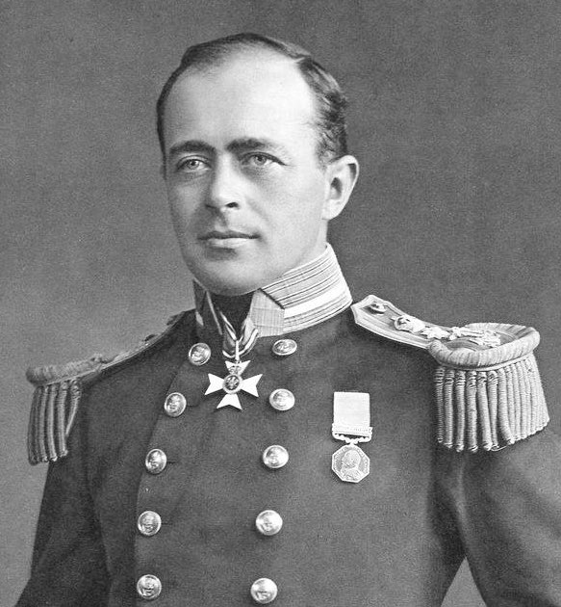
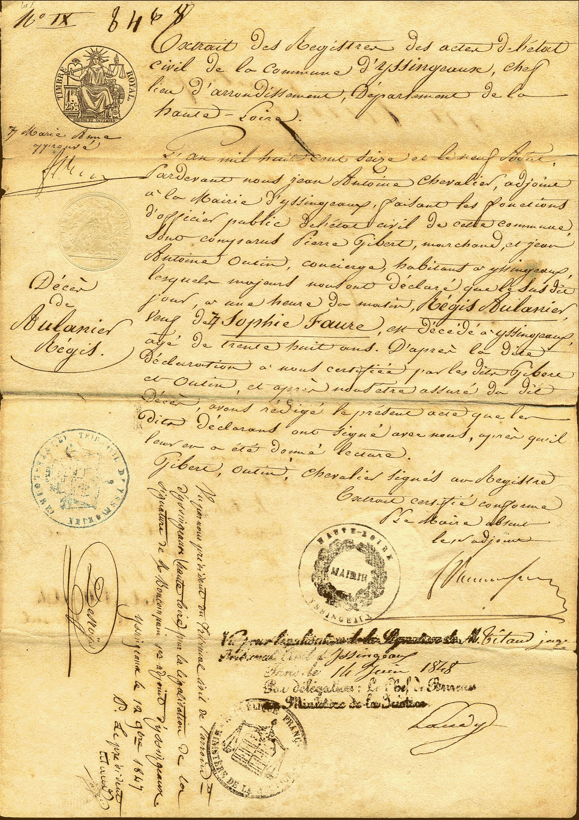
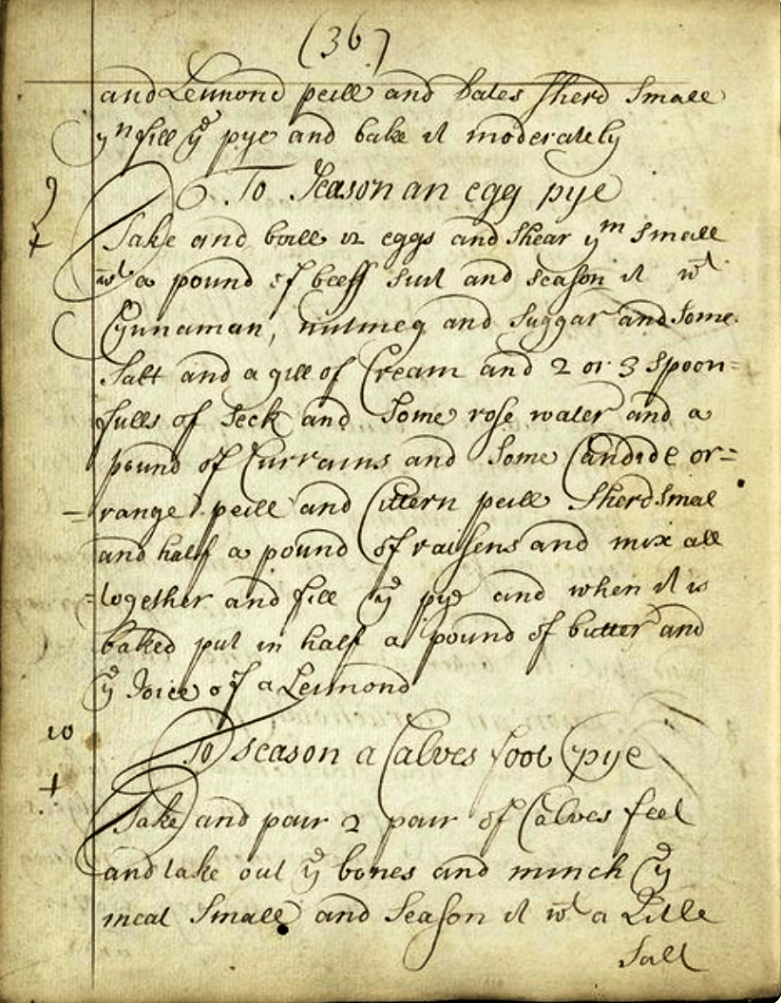
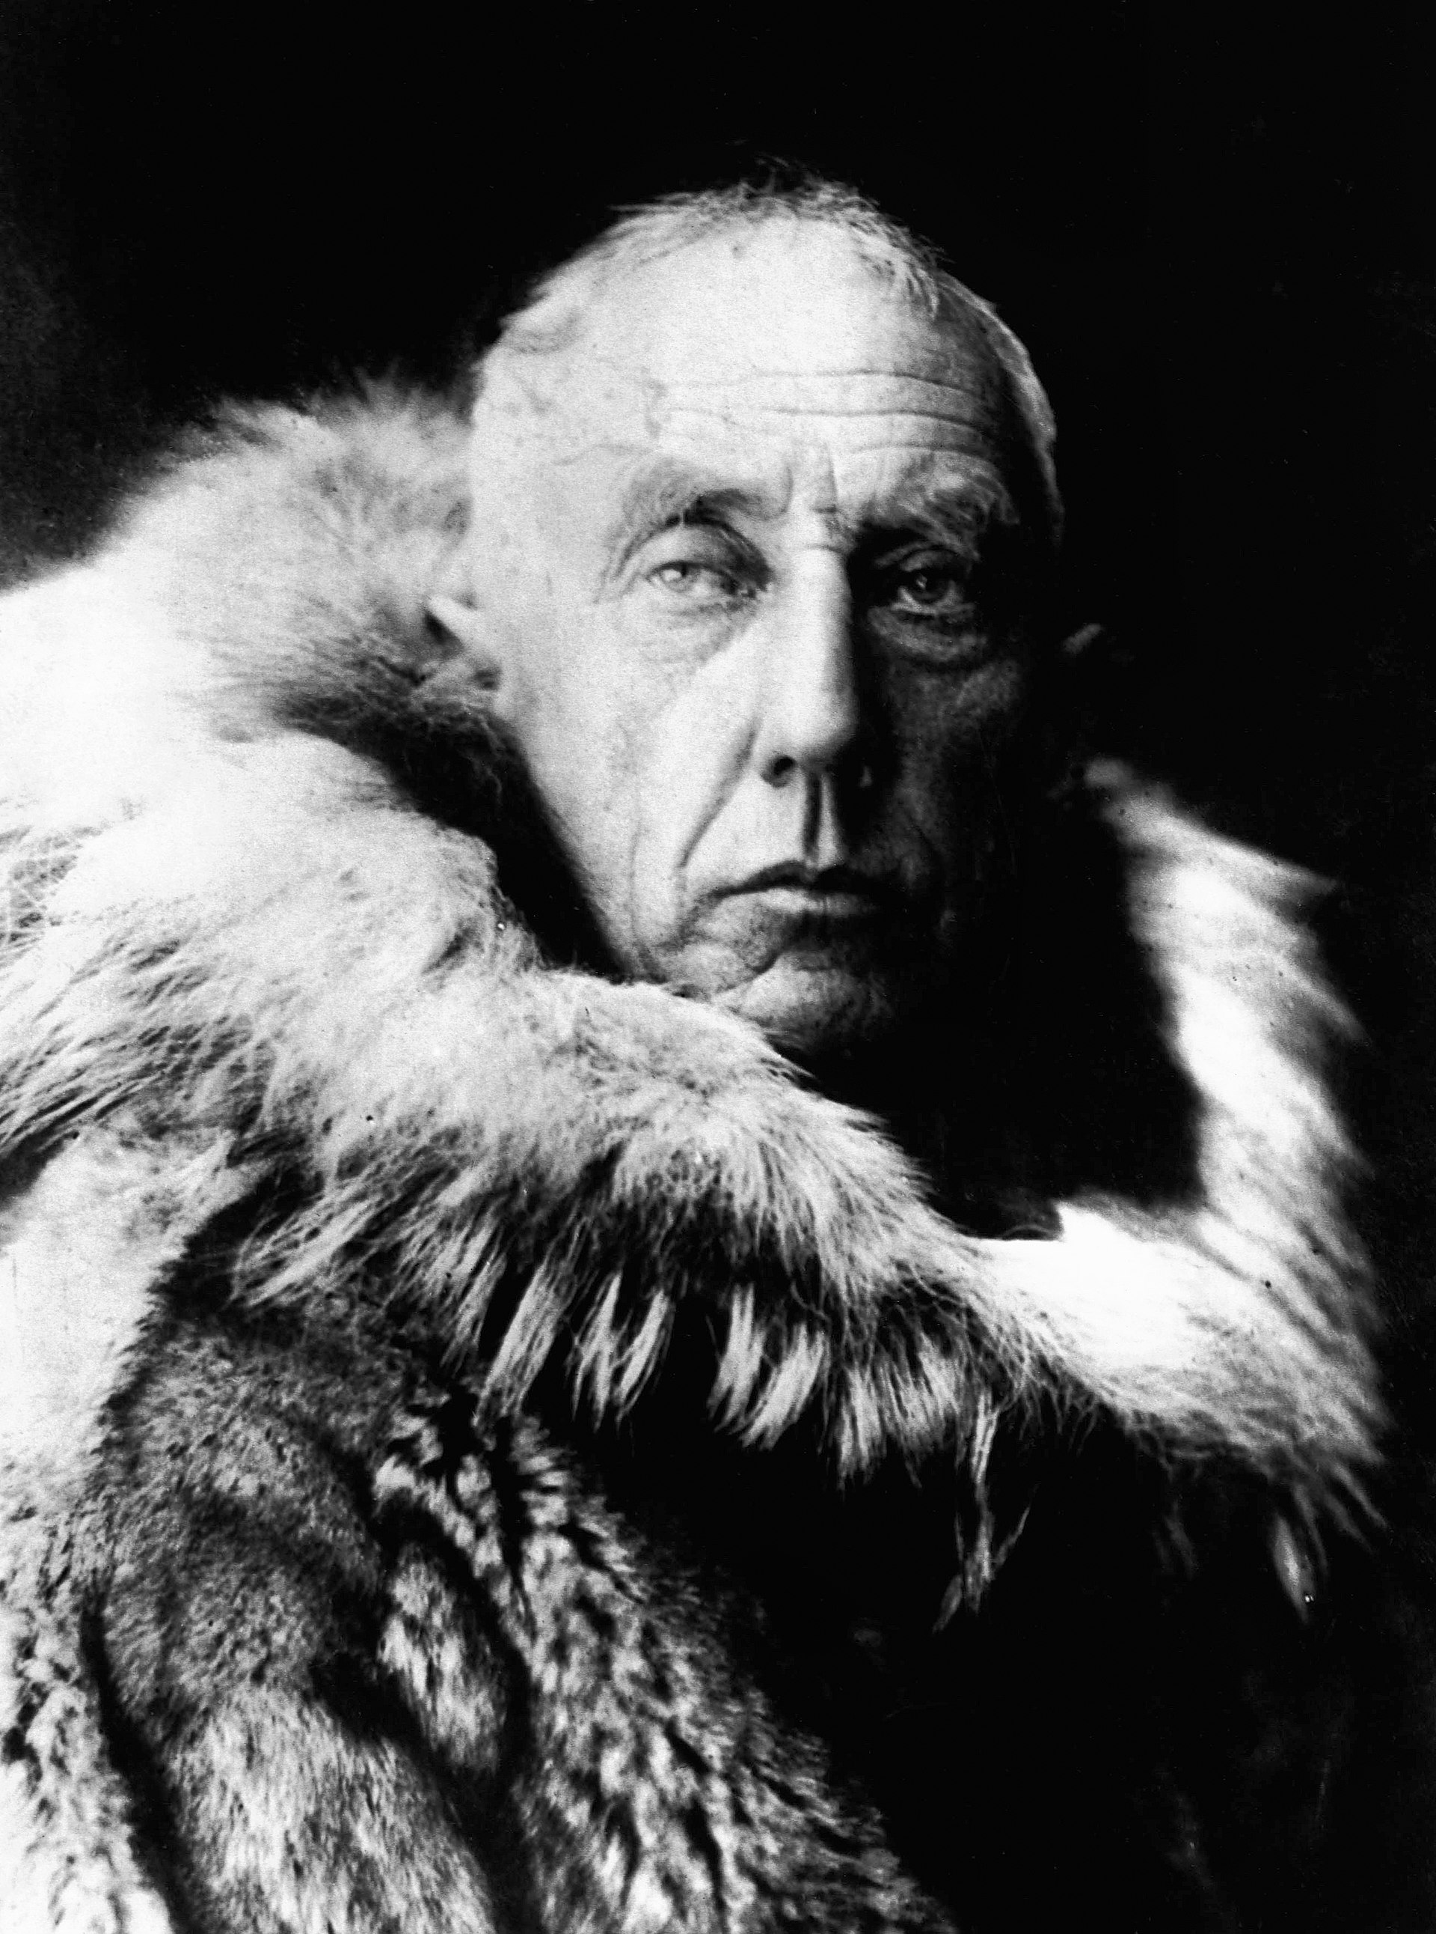
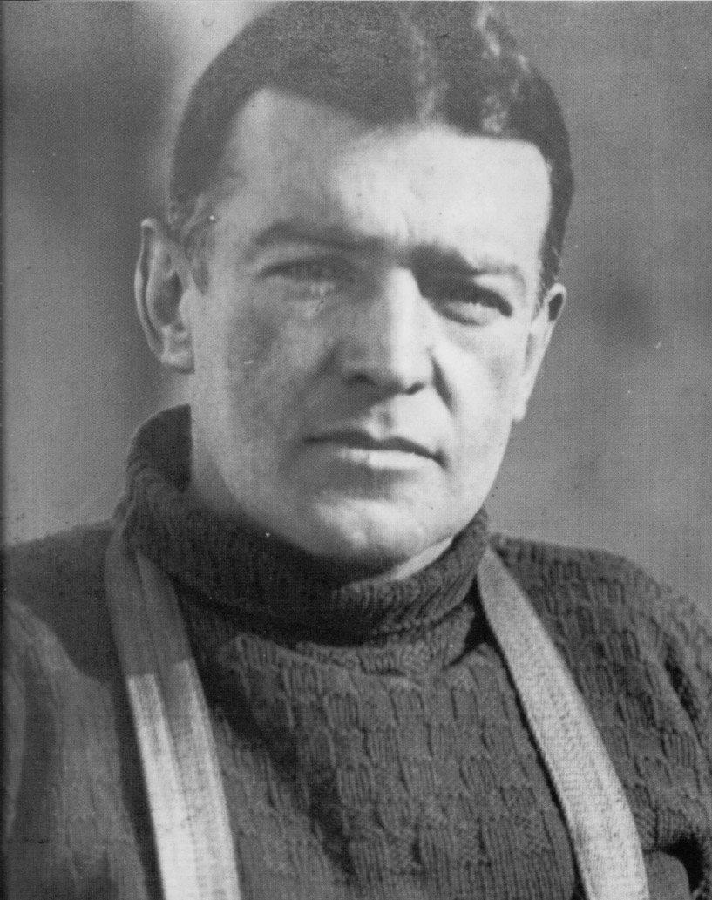
Journals containing “lessons learned” from all previous expeditions are archived in the library at South Georgia.
A Guide to Mt. Vinson
Life at the Ross Ice Shelf

Slide 43
IF YOU RECEIVE a journal, you must:
Stay behind 1 week in South Georgia for each journal you receive.

Slide 44
HOW TO RECEIVE A JOURNAL:
1. TELL A PROVISIONER.
2. They will send you the information VIA the Zoom Chat feature.
3. You will be directed to type in a word, HERE

